Slide 1








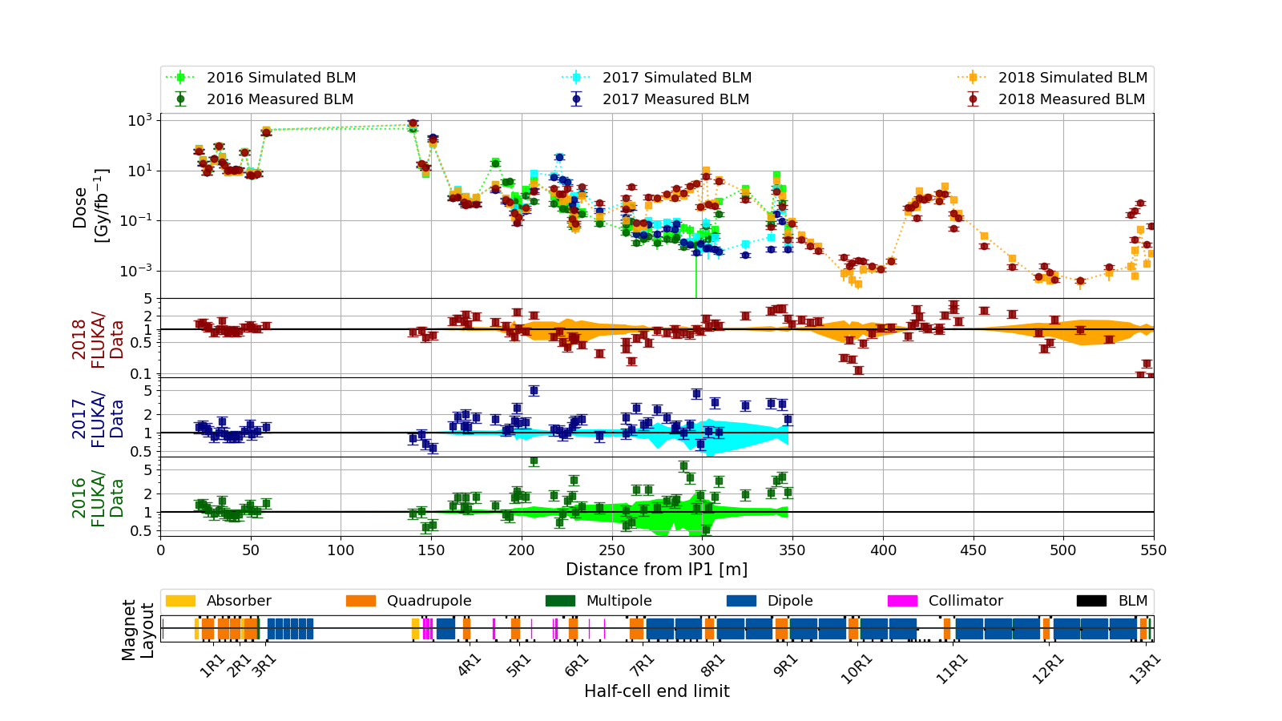
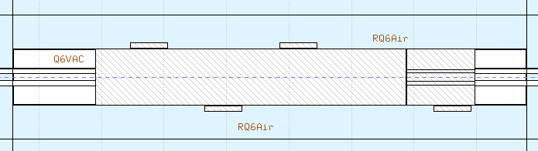
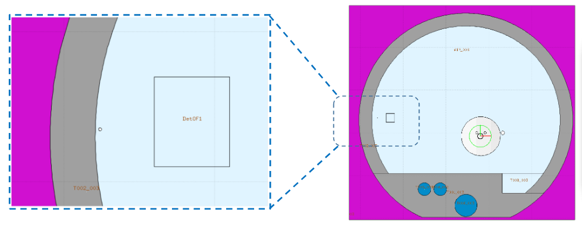
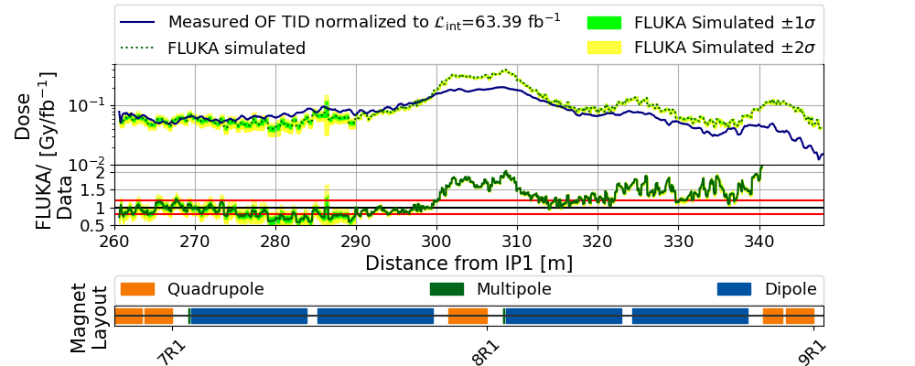
COMPARISON BETWEEN RUN 2 TID MEASUREMENTS AND FLUKA SIMULATIONS IN THE CERN LHC TUNNEL OF THE ATLAS INSERTION REGION
Daniel Prelipcean^{1,2} (daniel.prelipcean@cern.ch), Giuseppe Lerner¹, Rubén García Alía¹, Kacper Bilko¹, Marta Sabaté Gilarte¹, Francesco Cerutti¹, Diego Di Francesca¹, Daniel Ricci¹, Alessia Ciccotelli^{1,3}, Barbara Humann^{1,4}
¹CERN (CH-1211 Geneva), ²Technical University of Munich (DE-80333 München), ³University of Manchester (GB-M13 9PL Manchester), ⁴Technical University of Vienna (AT-1040 Wien)
1. The Large Hadron Collider (LHC)
4. Benchmark Results
A systematic benchmark between the simulated and the measured data for the radiation monitors useful for Radiation to Electronics (R2E) [1] studies at the Large Hadron Collider (LHC) [2] at CERN. The radiation levels in the main LHC tunnel on the right side of the Interaction Point 1 (ATLAS detector) are simulated using the FLUKA Monte Carlo code [3-5] and compared against Total Ionising Dose (TID) measurements performed with:
the Beam Loss Monitoring (BLM) system [6],
180 m of Distributed Optical Fibre Radiation Sensor (DOFRS) [7].
The comparison between the different years of operation reflects the impact of the LHC machine parameters on the radiation levels in a local region downstream, if not globally. Three years of Run 2 with different configurations are shown in Figure 2.
Fig. 1: BLM detectors around a quadrupole, as (upper) modelled in FLUKA and (lower) installed in the LHC.
2. Radiation levels in luminosity-driven in IPs
Fig. 2: Top pannel: Comparison between BLM data and FLUKA predictions for the tunnel in the right side of IP1 (ATLAS detector) for 3 years of Run 2 operation with different configurations: 2018 with LSS+DS+ARC TCL456: 15s-35s-park RP: IN (red), 2017 with LSS+DS TCL456: 15s-35s-20s RP: IN (blue), and 2016 with LSS+DS TCL456: 15s-15s-open RP: OUT (green). Center pannels: The ratio of FLUKA simulated values to the BLM measurements.
The main source of radiation in the LHC tunnel in IP1 are inelastic proton-proton collisions in the center of the ATLAS experiment (𝑧 = 0 m) whose debris partially propagates in the tunnel leading to radiation showers.
The discussion in this paper is focused on the TID, relevant for cumulated damage and lifetime degradation on machine equipment. The TID is defined as the energy deposited per unit mass by electromagnetic or hadronic showers via ionisation, and is measured by the BLM detectors and simulated with FLUKA.
Due to the origin of the showers, the BLM measurements are assumed to scale with luminosity, which is a measure of the number of inelastic collisions taking place in the IP. Still, there are several operational parameters of the LHC that can also affect the radiation levels near IP1. The ones examined in this study are:
Target Collimator Long (TCL) settings: aperture size (and usage) of the collimators protecting beam elements, such as the cold magnets in half-cells 8 and 9.
Roman Pots (RP) [8] settings: devices used to measure the total cross section of two particle beams in a collider.
Moreover, the symmetry around IP1 allows to reduce the study to only one side of the tunnel.
The results of Figure 3 exhibit a good agreement, with a (TID weighted) ratio average of 1.3±0.3 (standard deviation). There seems to be an overestimation particularly near the magnet interconnects which are not yet explicitly modelled in the simulation geometry, leading to less material budget absorbing radiation.
Fig. 3: Top pannel: Comparison between OF measured data (blue) and FLUKA predictions (green) for the DS in the right side of IP1 (ATLAS detector) for 2018. Center pannel: The ratio of FLUKA simulated values to the measured data. Lower pad: Machine beamline layout, with markers at the cell limits right of IP1.
5. Conclusions
This study aimed to test the understanding of the loss pattern and the mechanism generating the losses, as well as to validate the use of simulation tools like FLUKA and their predicting power in the difficult scenario of the LHC accelerator, which consists of a complex radiation field and for a radiation source propagating into a geometry that spans hundreds of meters. The general level of agreement that results from this study is a factor of 2 or better, with local outliers.
Used for the design of future accelerators and for the lifetime usage of several beam elements, the FLUKA Monte Carlo code can provide a much more detailed description of the radiation field compared to what the measurements can offer. The simulations benchmarked in this way allows to trust to similar levels of precision also all the other predictions that they provide (such as particle energy spectra or R2E-relevant quantities in positions where no radiation monitors are present and other quantities.)
3. Uncertainties and limitations
The main sources of uncertainty is considered to be the geometry
mismodelling, precision misalingments, etc. It is generally considered that for the complex and large accelerator, the elements are modelled correctly within a 10 cm accuracy and only the radiation monitors may have up to a 1 m shift [9]. Locally, some radiation monitors are placed in the close proximity of strong gradients of radiation,
implying that even a slightly shifted position could significantly change the overall agreement (e.g. 1 m gives almost a factor of 10 at 205 m from IP1).
References
M. Brugger. R2E and availability. In Proc. of Workshop on LHC Performance, Chamonix, France, 2014.
O. Brüning et al. LHC Design Report. CERN Yellow Reports: Monographs. CERN, Geneva, 2004. doi:10.5170/CERN-2004-003-V-1. URL https://cds.cern.ch/record/782076.
FLUKA website. URL https://fluka.cern.
C. Ahdida et al. New Capabilities of the FLUKA Multi-Purpose Code. Frontiers in Physics, 9, 2022. ISSN 2296-424X. URL https://www.frontiersin.org/article/10.3389/fphy.2021.788253.
G. Battistoni et al. Overview of the FLUKA code. Annals Nucl. Energy, 82:10–18, 2015. doi: 10.1016/j.anucene.2014.11.007
E. B. Holzer et al. Beam loss monitoring system for the LHC. IEEE Nuclear Science Symposium, 2:1052 –1056, November 2005. doi: 10.1109/NSSMIC.2005.1596433.
D. Di Francesca et al., »Dosimetry Mapping of Mixed-Field Radiation Environment Through Combined Distributed Optical Fiber Sensing and FLUKA Simulation«, in: IEEE Transactions on Nuclear Science 66.1 (2019), pp. 299–305.
M. Oriunno et al. The Roman Pot for LHC, 2006. URLhttps://cds.cern.ch/record/1078513.
A. Lechner et al. Validation of energy deposition simulations for proton and heavy ion losses in the CERN
Large Hadron Collider. Phys. Rev. Accel. Beams, 22:071003, Jul 2019. URL https://link.aps.org/doi/10.1103/PhysRevAccelBeams.22.071003

